Slide 1
Files

Slide 2
Files and the file system
Introduction to Computing Using Python
root folder
/
/
The file system is the OS component that organizes files and provides a way to create, access, and modify files
Applications
bin
Users
Applications
bin
Users
var
var
Mail.app
Firefox.app
Shared
Mail.app
Firefox.app
messi
Shared
messi
poem.txt
Files are organized into a tree structure
Contents
Contents
image.jpg
poem.txt
Canon
Canon
folders (or directories)
folders (or directories)
regular files
MacOS
MacOS
binary file
text file
While every file and folder has a name, it is the file pathname that identifies the file
Mail
Relative pathnames
(relative to current working directory Users)
messi/poem.txt
messi/image.jpg
Shared
Absolute pathnames
/var/poem.txt
/Users/messi/poem.txt
/Applications/Mail.app/

Slide 3
Opening and closing a file
Introduction to Computing Using Python
Processing a file consists of:
Opening the file
Reading from and/or writing to the file
Closing the file

Slide 4
Opening and closing a file
Introduction to Computing Using Python
Processing a file consists of:
Opening the file
Reading from and/or writing to the file
Closing the file
Built-in function open() is used to open a file
The second (optional) argument is the file mode
The first input argument is the file pathname, whether absolute or relative with respect to the current working directory
Returns a “file” object
>>> infile = open('example.txt', 'r')
>>> infile.close()
>>>

Slide 5
Open file mode
Introduction to Computing Using Python
The file mode defines how the file will be accessed
Mode | Description
r | Reading (default)
w | Writing (if file exists, content is wiped)
a | Append (if file exists, writes are appended)
r+ | Reading and Writing
t | Text (default)
b | Binary
>>> infile = open('example.txt', 'rt')
>>> infile = open('example.txt', 'r')
>>> infile = open('example.txt', 't')
>>> infile = open('example.txt')
These are all equivalent

Slide 6
Cursor
Represents a location within a file where the next operation (read/write) will be performed.
Mode | Description | Cursor (initial location)
r | Reading (default) | Beginning of the file
w | Writing (if file exists, content is wiped) | Beginning of the file
a | Append (if file exists, writes are appended) | End of the file
r+ | Reading and Writing | Beginning of the file

Slide 7
File methods
Introduction to Computing Using Python
Methods read() and readline() return the characters read as a string
Methods readlines() returns the characters read as a list of lines
Method write() returns the number of characters written
There are several “file” types; they all support similar “file” methods
Usage | Description
infile.read(n) | Read n characters starting from cursor; if fewer than n characters remain, read until the end of file
infile.read() | Read starting from cursor up to the end of the file
infile.readline() | Read starting from cursor up to, and including, the end of line character
infile.readlines() | Read starting from cursor up to the end of the file and return list of lines
outfile.write(s) | Write string s to file outfile starting from cursor
infile.close(n) | Close file infile

Slide 8
Reading a file
Introduction to Computing Using Python
1 The 3 lines in this file end with the new line character.\n
2 \n
3 There is a blank line above this line.\n
example.txt
When the file is opened, a cursor is associated with the opened file
>>> infile = open('example.txt')
>>>
>>> infile = open('example.txt')
>>> infile.read(1)
'T'
>>> infile.read(5)
'he 3 '
>>> infile.readline()
'lines in this file end with the new line character.\n'
>>>
>>> infile = open('example.txt')
>>> infile.read(1)
'T'
>>> infile.read(5)
'he 3 '
>>> infile.readline()
'lines in this file end with the new line character.\n'
>>> infile.read()
'\nThere is a blank line above this line.\n'
>>>
>>> infile = open('example.txt')
>>> infile.read(1)
'T'
>>> infile.read(5)
'he 3 '
>>> infile.readline()
'lines in this file end with the new line character.\n'
>>> infile.read()
'\nThere is a blank line above this line.\n'
>>> infile.close()
>>>
>>> infile = open('example.txt')
>>> infile.read(1)
'T'
>>>
>>> infile = open('example.txt')
>>> infile.read(1)
'T'
>>> infile.read(5)
'he 3 '
>>>
The initial position of the cursor is:
at the beginning of the file, if file mode is r
at the end of the file, if file mode is a or w

Slide 9
Patterns for reading a text file
Introduction to Computing Using Python
Common patterns for reading a file:
Read the file content into a string
Read the file content into a list of words
Read the file content into a list of lines
Example:
def numChars(filename):
'returns the number of characters in file filename'
infile = open(filename, 'r')
content = infile.read()
infile.close()
return len(content)

Slide 10
Patterns for reading a text file
Introduction to Computing Using Python
Common patterns for reading a file:
Read the file content into a string
Read the file content into a list of words
Read the file content into a list of lines
Example:
def numWords(filename):
'returns the number of words in file filename'
infile = open(filename)
content = infile.read()
infile.close()
wordList = content.split()
return len(wordList)

Slide 11
Patterns for reading a text file
Introduction to Computing Using Python
Common patterns for reading a file:
Read the file content into a string
Read the file content into a list of words
Read the file content into a list of lines
Example:
def numLines(filename):
'returns the number of lines in file filename'
infile = open(filename, 'r’)
lineList = infile.readlines()
infile.close()
return len(lineList)

Slide 12
Writing to a text file
Introduction to Computing Using Python
1 This is the first line.
2
3
4
1 This is the first line. Still the first line…\n
2 Now we are in the second line.\n
3 Non string value like 5 must be converted first.\n
4 Non string value like 5 must be converted first.\n
1
2
3
4
1 T
2
3
4
1 This is the first line. Still the first line…\n
2
3
4
1 This is the first line. Still the first line…\n
2 Now we are in the second line.\n
3
4
1 This is the first line. Still the first line…\n
2 Now we are in the second line.\n
3 Non string value like 5 must be converted first.\n
4
test.txt
>>> outfile = open('test.txt', 'w')
>>> outfile.write('T')
1
>>>
>>> outfile = open('test.txt', 'w')
>>> outfile.write('T')
1
>>> outfile.write('his is the first line.')
22
>>> outfile.write(' Still the first line...\n')
25
>>> outfile.write('Now we are in the second line.\n')
31
>>>
>>> outfile = open('test.txt', 'w')
>>>
>>> outfile = open('test.txt', 'w')
>>> outfile.write('T')
1
>>> outfile.write('his is the first line.')
22
>>>
>>> outfile = open('test.txt', 'w')
>>> outfile.write('T')
1
>>> outfile.write('his is the first line.')
22
>>> outfile.write(' Still the first line...\n')
25
>>>
>>> outfile = open('test.txt', 'w')
>>> outfile.write('T')
1
>>> outfile.write('his is the first line.')
22
>>> outfile.write(' Still the first line...\n')
25
>>> outfile.write('Now we are in the second line.\n')
31
>>> outfile.write('Non string value like '+str(5)+' must be converted first.\n')
49
>>>
>>> outfile = open('test.txt', 'w')
>>> outfile.write('T')
1
>>> outfile.write('his is the first line.')
22
>>> outfile.write(' Still the first line...\n')
25
>>> outfile.write('Now we are in the second line.\n')
31
>>> outfile.write('Non string value like ‘+ str(5)+' must be converted first.\n')
49
>>> outfile.write('Non string value like {} must be converted first.\n'.format(5))
49
>>> outfile.close()

Slide 13
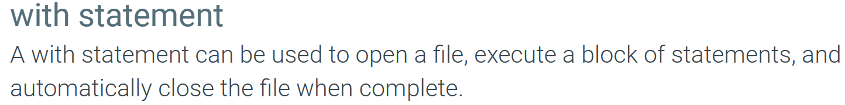
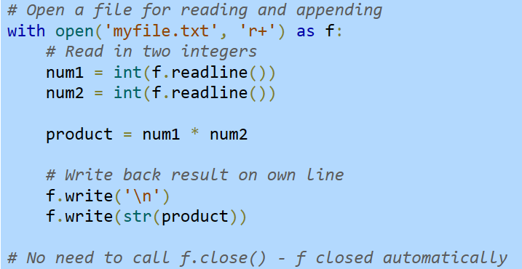

Slide 14
Command-line arguments and files
python script.py arg1 arg2 …
Argument vector (sys.argv)
Example:
python script.py my_file.txt
sys.argv[0] ~ ‘script.py’
sys.argv[1] ~ ‘myfile.txt’
python script.py my_file.txt 3
sys.argv[0] ~ ‘script.py’
sys.argv[1] ~ ‘myfile.txt’
sys.argv[2] ~ ‘3’ (string)

Slide 15
Why needed?
Flexible input
Help to keep the program generic
Helps automation
Testing and debugging

Slide 16


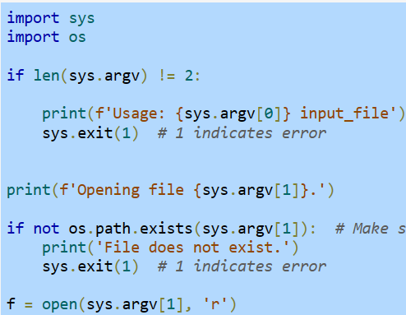
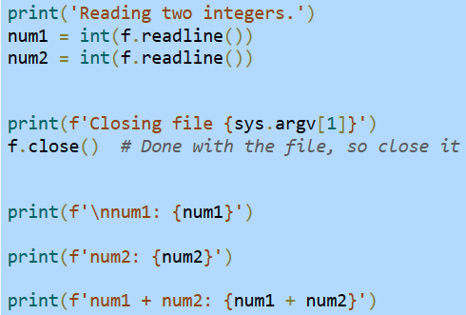
Example
script.py
script.py (cont.)
>python script.py myfile1.txt

Slide 17
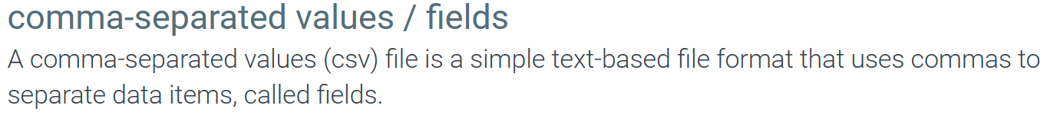
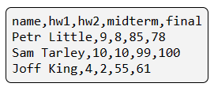
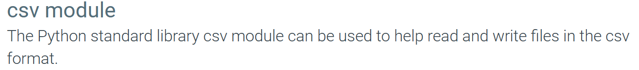
Comma-separated values files (CSV)

Slide 18
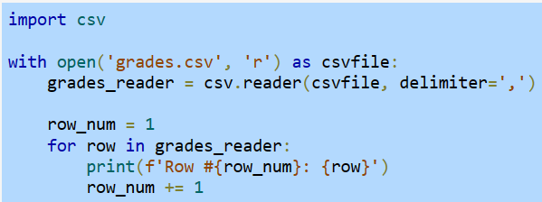

Reading each row of a csv file

Slide 19
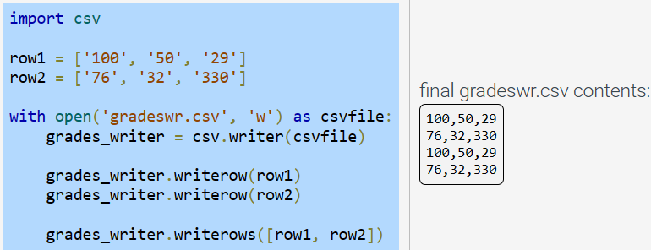
Writing rows to a csv file

Slide 20
Recommended Reading from ZyBook
12.1 Reading files
12.2 Writing files
12.3 Interacting with file systems
12.5 Command line arguments and files
12.6 The with statement
12.7 Comma-separated values

Slide 21
Attendance

